Slide 1

Long distance Communication
Evolution of long-distance communication

Slide 2
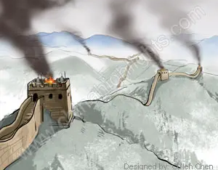
Started with Smoke signals
The use of smoke by tribes in North America. Smoke at the top of a hill meant danger.
Smoke was also used in ancient china on the great wall from tower to tower. the signal would reach 750 km in just a few hours.

Slide 3
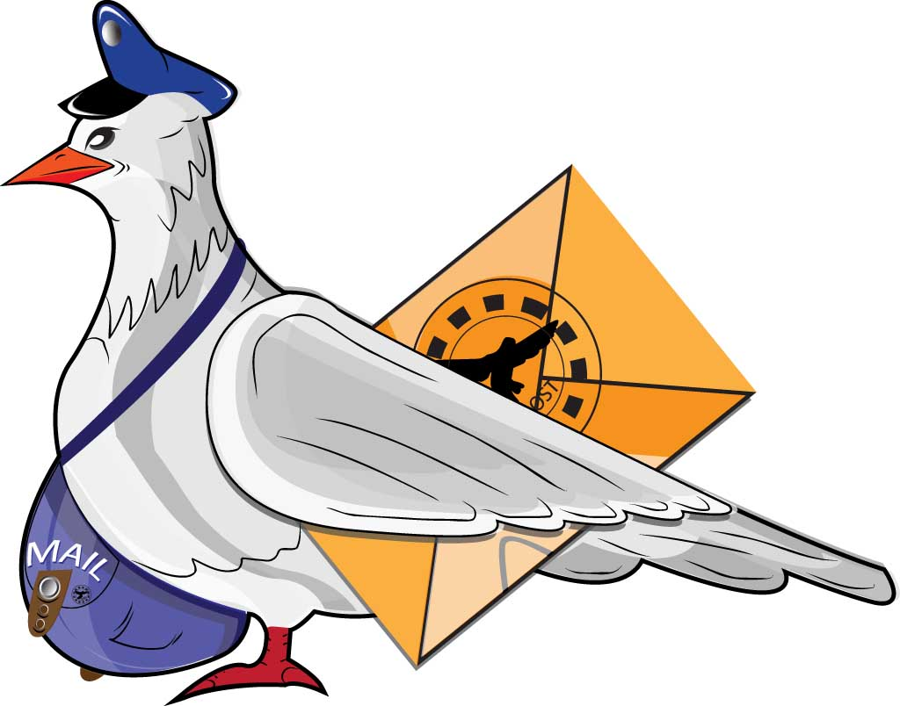
Pigeon Messengers
Pigeons were used by Persians, Greeks, and Romans to transfer messages from one city to another.
Also in WWI

Slide 4
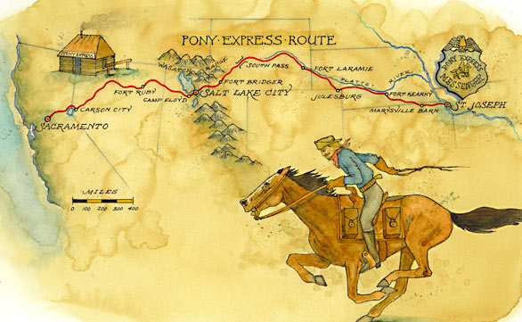
Pony Express
Pony express using horses to deliver mail, in the mid 19th century to communicate from east coast to west coast.

Slide 5
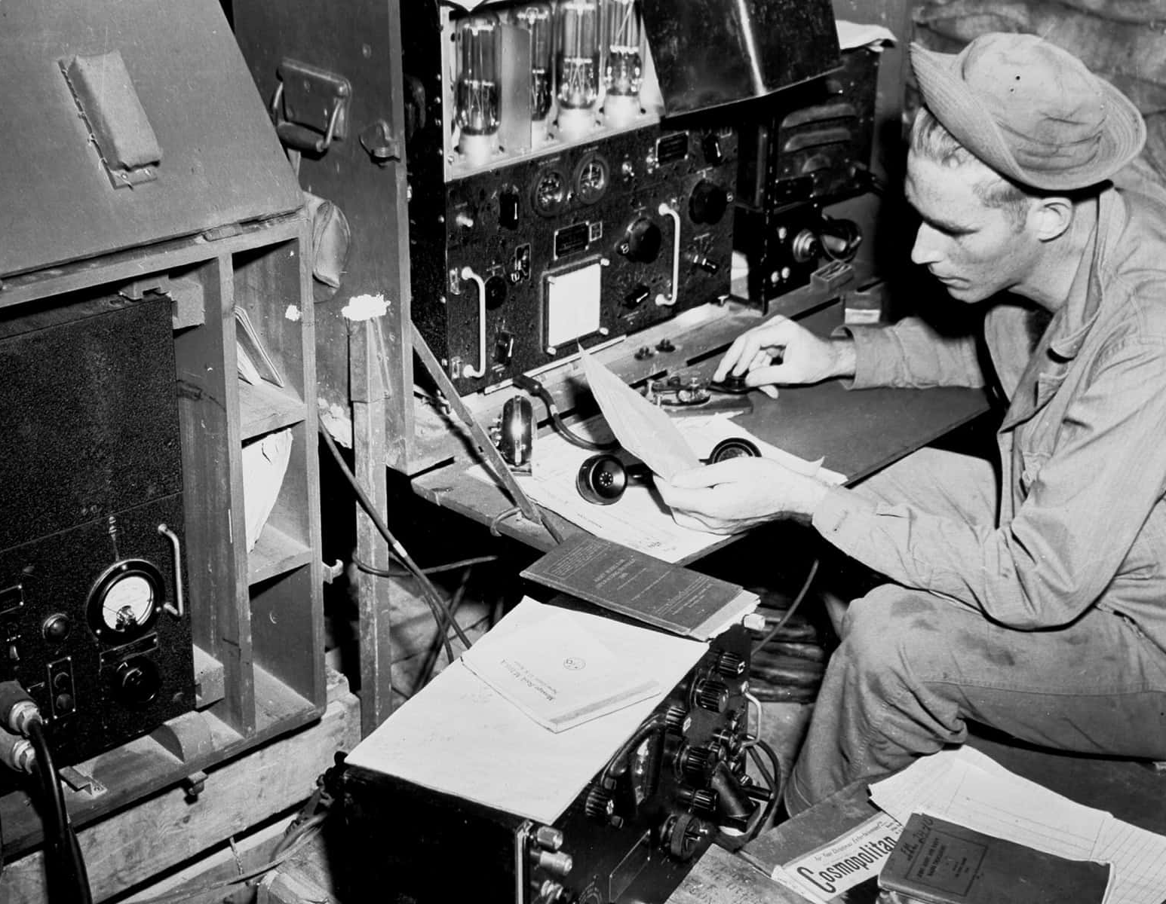
Morse Code
morse code is still used until a couple decades ago.

Slide 6
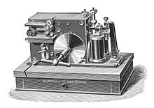
Radio and Telephone
Beginning of a new era of long-distance communication.
Radio created in late 1800s by Heinrich hertz.
Early 20th century radio system was able to produce continuous waves to send voice and music.
Before the telephone real time communication was only used for broadcasting.
Wireless telephone systems which were just push to talk(one-way comm) until the 1960s the telephone was improved to receiving and transmitting using two channels.

Slide 7
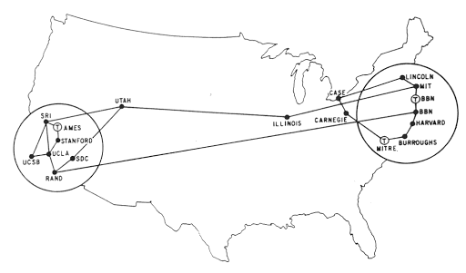
Arpanet
Arpanet was small network of computers hosted at universities connected at different ends of the country.
Invented breaking the information into chunks known as packets
As more cities were being added the hubs couldn’t handle the bandwidth

Slide 8
Mixed packets
Traffic was too much which led to the creation of mixed packets.
Add packets together and send them as one
the receiver would then unmix these packets.

Slide 9
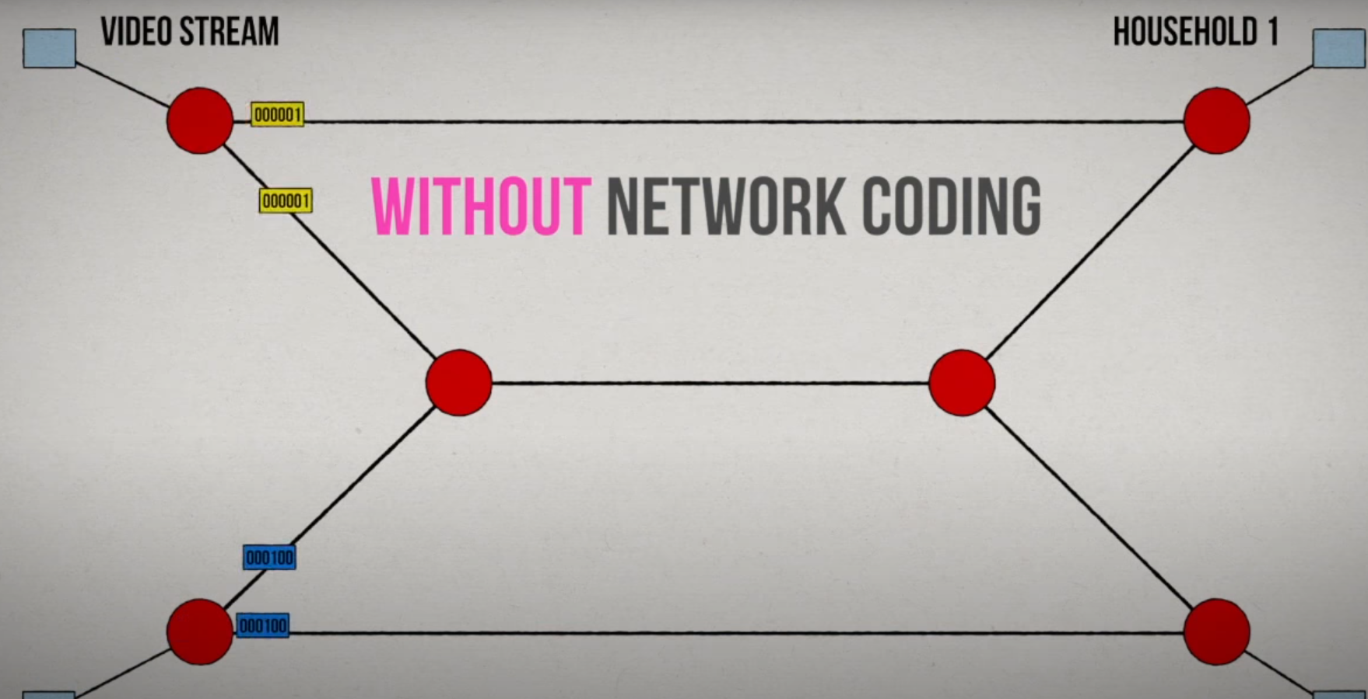
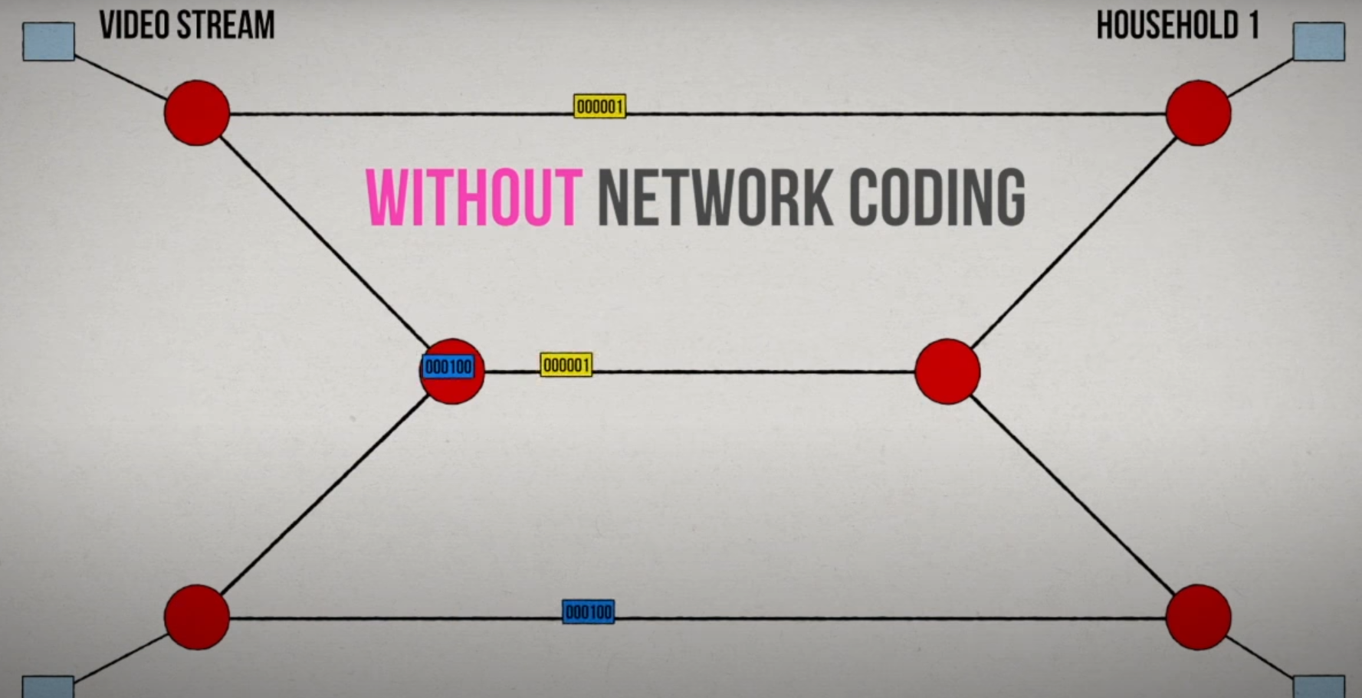
Mixed Packet

Slide 10
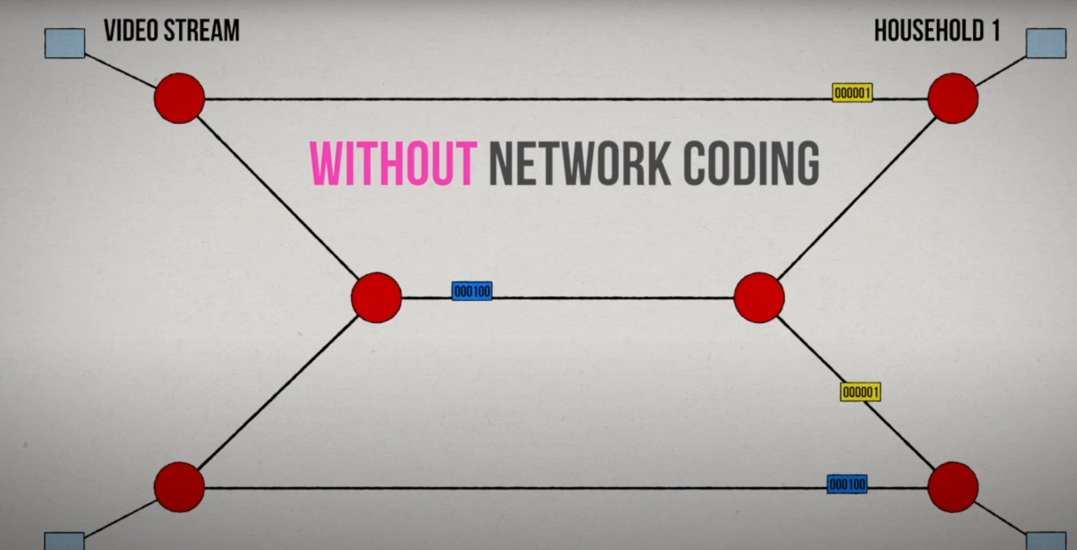
Mixed Packet

Slide 11
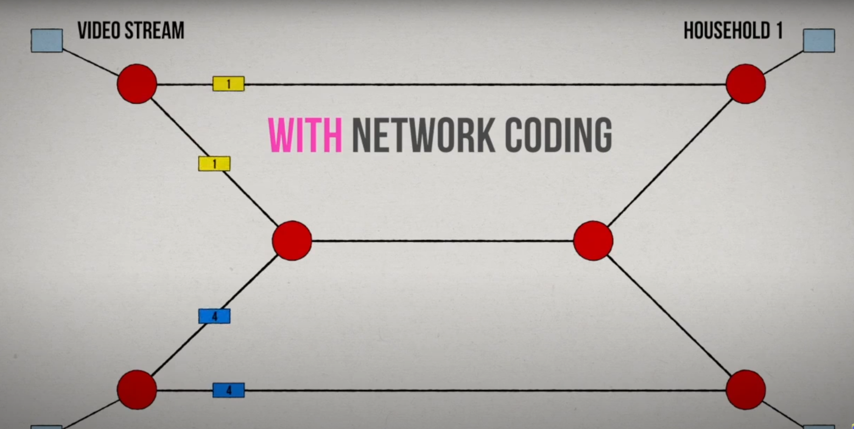
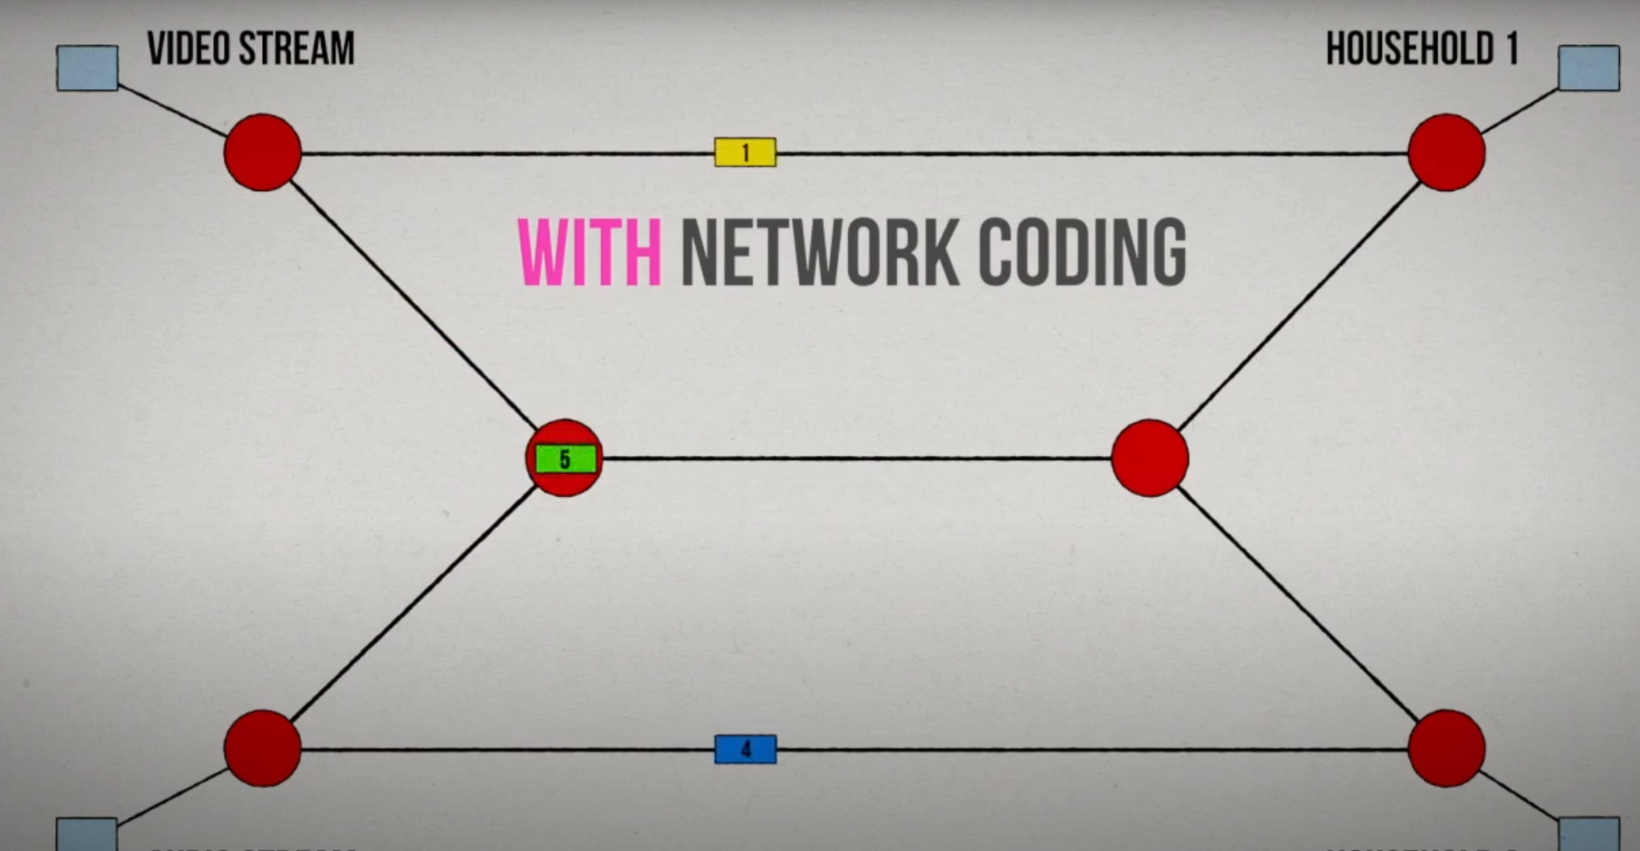
Mixed Packet

Slide 12
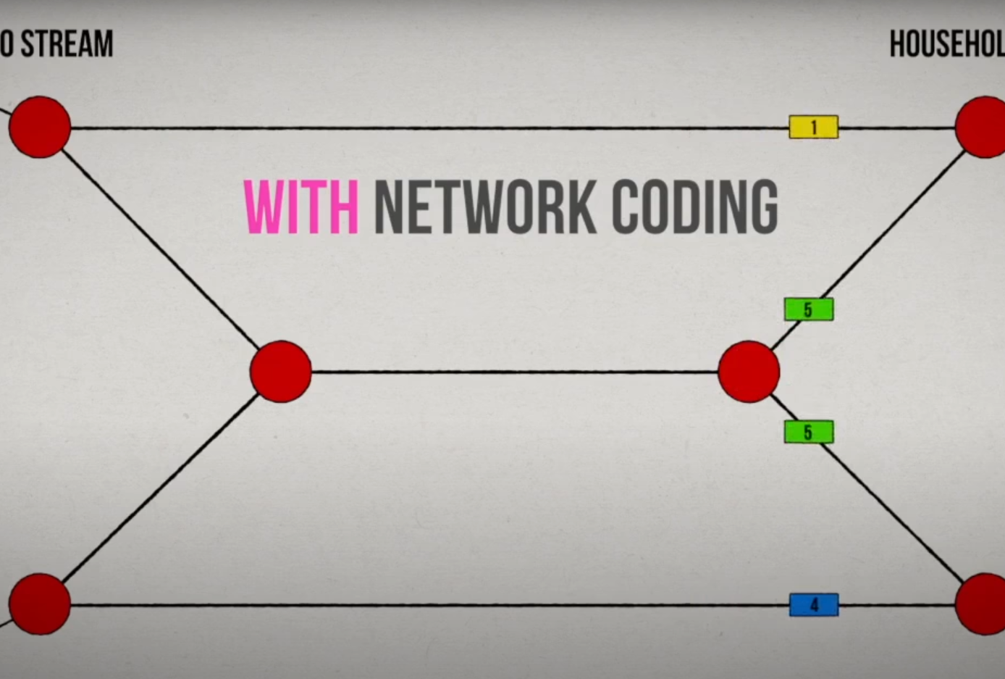
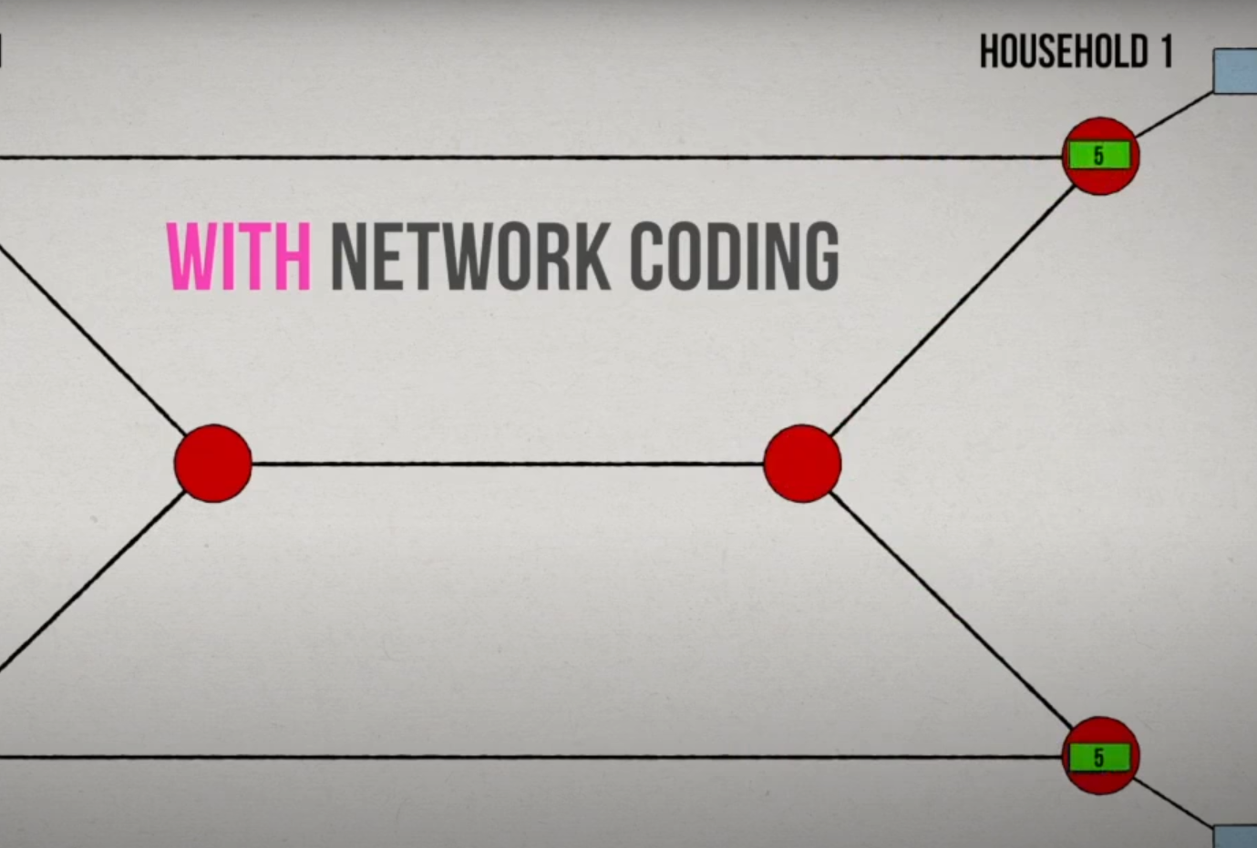
Mixed Packet

Slide 13
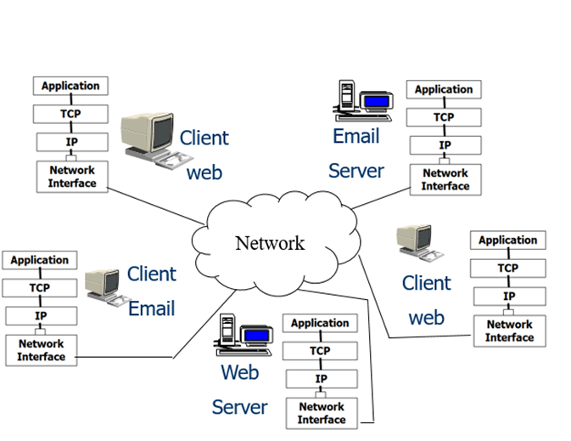
Tcp/IP
TCP-transmission control protocol. divides file/messages into packets on the source computer. also used to reassemble the packets on the receiving end.
IP internet protocol is used to handle the address of the destination so that the packets are sent to the right destination.

Slide 14
Interspace
Interspace modern day internet.
Allows multiple users to communicate online with real-time audio, video, and text chat
Most advanced form of communication available today.

Slide 15

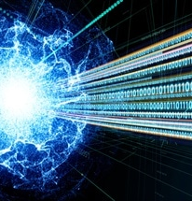
Photonics
Optical fiber is backbone of todays communication networks.
Optical cables made of glass carry data in the form of light signals/modes.
Has a cladding layer surrounds core to keep light from escaping.

Slide 16
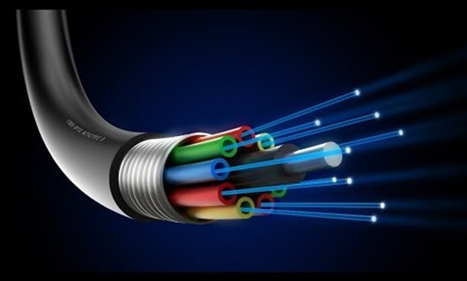
Fiber cable
Optical fiber stronger than steel
More durable than copper
Unsusceptible to lightening
Does not corrode or rust
Very reliable
Cost effective, durable and low attenuation.

Slide 17
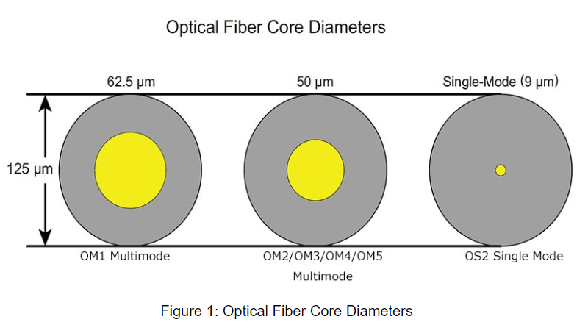
Single Mode
Smaller in diameter
Lower attenuation
Higher transmission speed
Longer distances

Slide 18
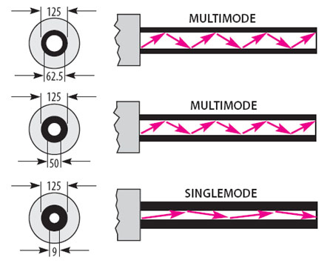
Multimode
Bigger in diameter
Higher bandwidth
Carries multiple modes simultaneously

Slide 19
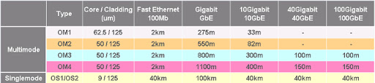
Multi Mode vs Single Mode

Slide 20
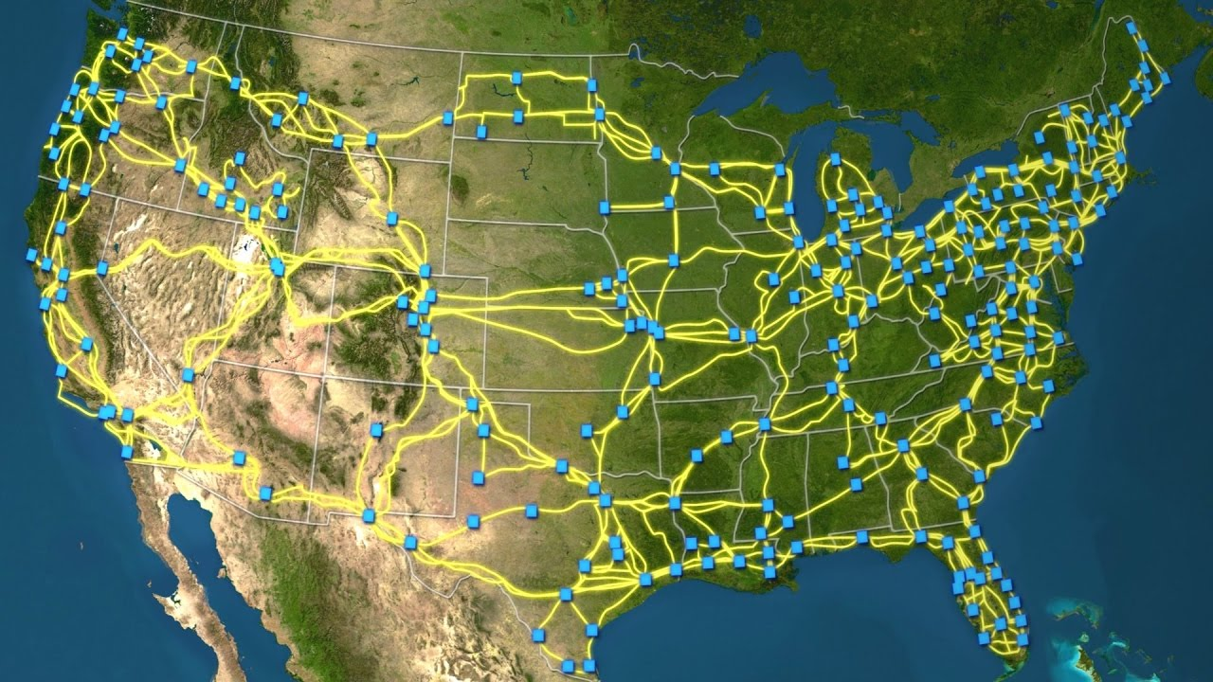
Fiber Optic Availability

Slide 21
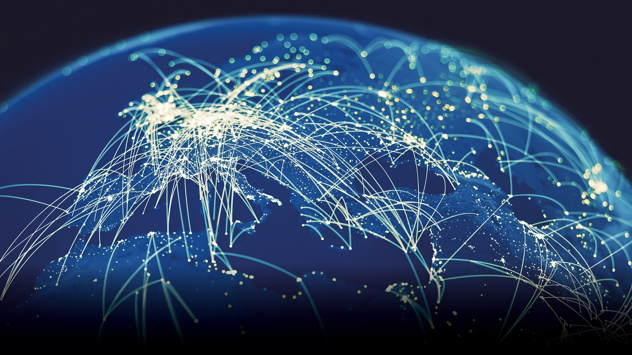
What is Next?

